Slide 1
Bash shell scripting

Slide 2
Basic Shell Programming
A script is a file that contains shell commands
data structure: variables
control structure: sequence, decision, loop
Shebang line for bash shell script:
#! /bin/bash
#! /bin/sh
to run:
make executable: % chmod +x script
invoke via: % ./script

Slide 3
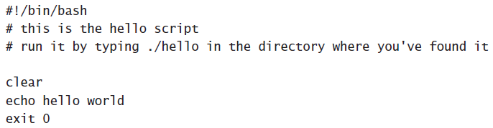
If the parent shell reads exit 0, it knows the script
has executed successfully.
use exit 1 as a generic error message, exit 2 to specify that a specific condition was not met

Slide 4
Working with Variables and Input
To define a variable, use varname=value to get the value of a variable.
nuuk:~ # HAPPY=yes
nuuk:~ # echo $HAPPY
Yes
#!/bin/bash
#
# dirscript
#
# Script that creates a directory with a certain name next sets $USER and $GROUP as the owners of the directory # and finally changes the permission mode to 770
DIRECTORY=/blah
USER=linda
GROUP=sales
mkdir $DIRECTORY
chown $USER $DIRECTORY
chgrp $GROUP $DIRECTORY
chmod 770 $DIRECTORY
exit 0

Slide 5
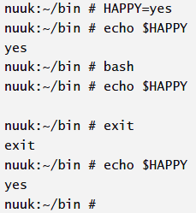
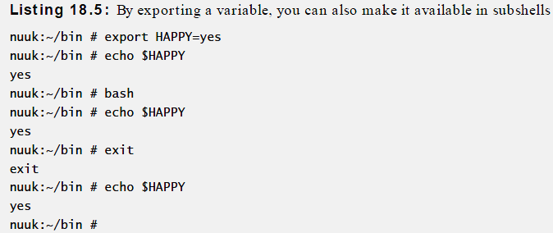

Slide 6
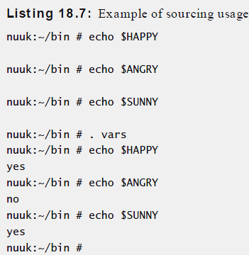
By putting all your variables in one file vars, you can make them easily available
HAPPY=yes
ANGRY=no
SUNNY=yes
you would use the . vars command. With . vars, you include the contents of vars in the current shell

Slide 7
Working with Script Arguments
#!/bin/bash
#
# dirscript
DIRECTORY=$1
USER=$2
GROUP=$3
mkdir /$DIRECTORY
chown $USER $DIRECTORY
chgrp $GROUP $DIRECTORY
Chmod 770 $DIRECTORY
exit 0
To execute the script from this exercise, use a command such as
dirscript /somedir kylie sales

Slide 8
Special shell variables
Parameter | Meaning
$0 | Name of the current shell script
$1-$9 | Positional parameters 1 through 9
$# | The number of positional parameters
$* | All positional parameters, “$*” is one string
$@ | All positional parameters, “$@” is a set of strings
$? | Return status of most recently executed command
$$ | Process id of current process

Slide 9
Examples: Command Line Arguments
% set tim bill ann fred
$1 $2 $3 $4
% echo $*
tim bill ann fred
% echo $#
4
% echo $1
tim
% echo $3 $4
ann fred
The ‘set’ command can be used to assign values to positional parameters

Slide 10
User input
shell allows to prompt for user input
Syntax:
read varname [more vars]
or
read –p "prompt" varname [more vars]
words entered by user are assigned to
varname and “more vars”
last variable gets rest of input line

Slide 11
User input example
#! /bin/sh
read -p "enter your name: " first last
echo "First name: $first"
echo "Last name: $last"

Slide 12

#!/bin/bash
echo Enter some text
read SOMETEXT
echo -e "You have entered the following text:\t $SOMETEXT"
exit 0
echo -e is used in this sample script. This option allows you to use special formatting characters.

Slide 13
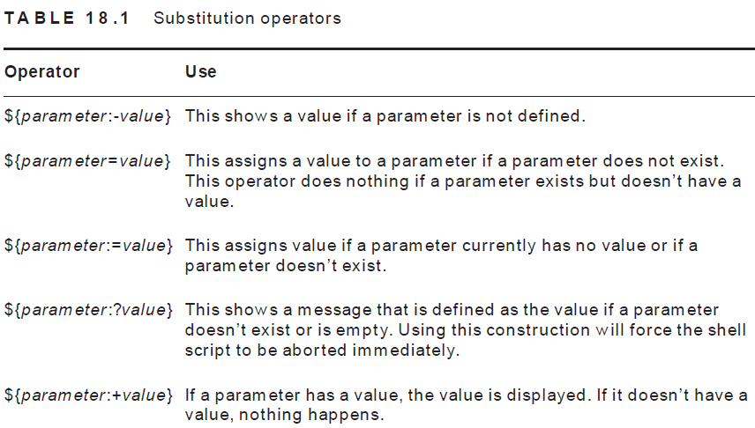

Slide 14
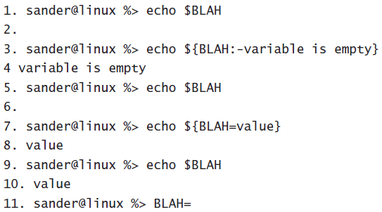
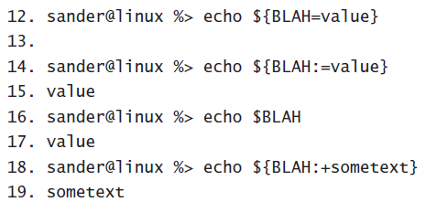

Slide 15
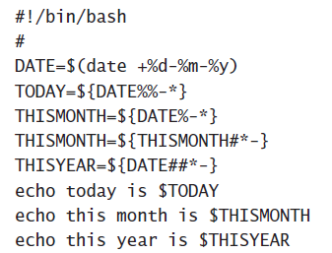


Slide 16
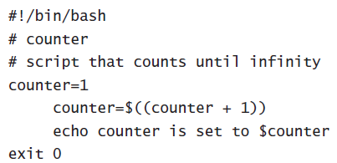
Performing Calculations

Slide 17
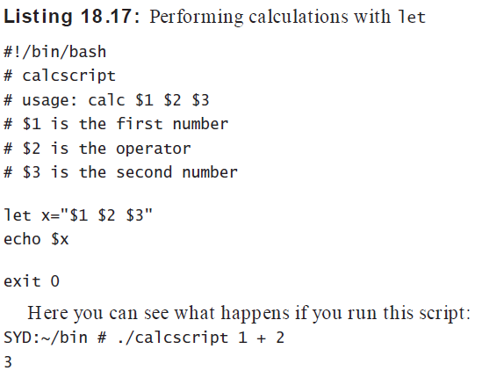

Slide 18
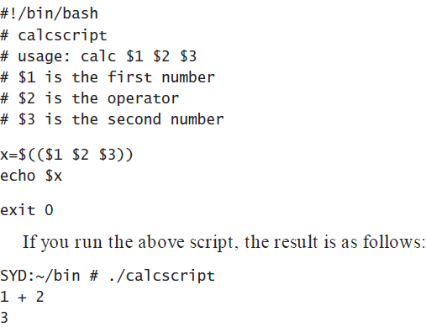

Slide 19
Relational Operators
Meaning | Numeric | String
Greater than | -gt
Greater than or equal | -ge
Less than | -lt
Less than or equal | -le
Equal | -eg | = or ==
Not equal | -ne | !=
str1 is less than str2 |  | str1 < str2
str1 is greater str2 |  | str1 > str2
String length is greater than zero |  | -n str
String length is zero |  | -z str

Slide 20
Compound logical expressions
! not
&& and
|| or
and, or
must be enclosed within
[[ ]]

Slide 21
bash control structures
if-then-else
case
loops
for
while
until
select

Slide 22
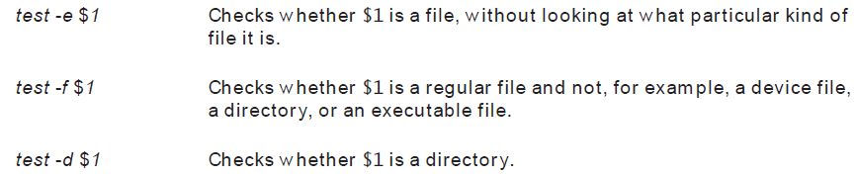
The test command. This command is used to perform many checks to see, for example, if a file exists or if a variable has a value.

Slide 23
File Testing
Meaning
-d file True if ‘file’ is a directory
-f file True if ‘file’ is an ord. file
-r file True if ‘file’ is readable
-w file True if ‘file’ is writable
-x file True if ‘file’ is executable
-s file True if length of ‘file’ is nonzero

Slide 24
test command
Syntax:
test expression
[ expression ]
evaluates ‘expression’ and returns true or false
Example:
if test –w "$1"
then
echo "file $1 is write-able"
fi

Slide 25
The simple if statement
if [ condition ]; then
statements
fi
executes the statements only if condition is true

Slide 26
The if-then-else statement
if [ condition ]; then
statements-1
else
statements-2
fi
executes statements-1 if condition is true
executes statements-2 if condition is false

Slide 27
The if…statement
if [ condition ]; then
statements
elif [ condition ]; then
statement
else
statements
fi
The word elif stands for “else if”
It is part of the if statement and cannot be used by itself

Slide 28
Example: Using the ! Operator
#!/bin/bash
read -p "Enter years of work: " Years
if [ ! "$Years" -lt 20 ]; then
echo "You can retire now."
else
echo "You need 20+ years to retire"
fi

Slide 29
case pattern
checked against word for match
may also contain:
*
?
[ … ]
[:class:]
multiple patterns can be listed via:
|

Slide 30
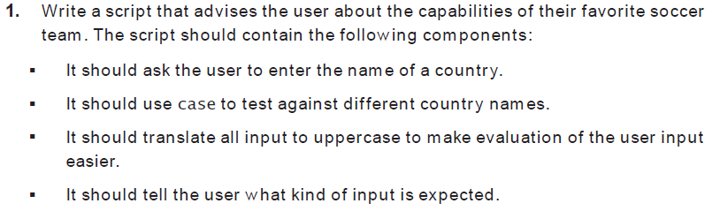

Slide 31
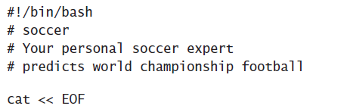
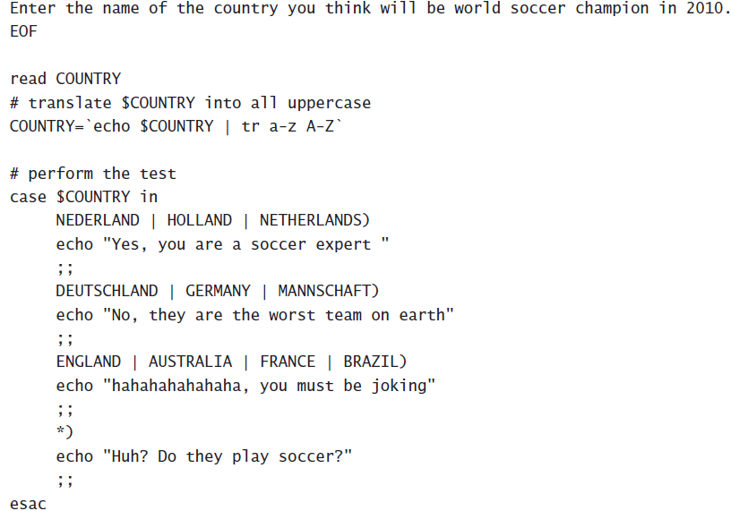

Slide 32
Example 2: The case Statement
#!/bin/bash
ChildRate=3
AdultRate=10
SeniorRate=7
read -p "Enter your age: " age
case $age in
[1-9]|[1][0-2]) # child, if age 12 and younger
echo "your rate is" '$'"$ChildRate.00" ;;
# adult, if age is between 13 and 59 inclusive
[1][3-9]|[2-5][0-9])
echo "your rate is" '$'"$AdultRate.00" ;;
[6-9][0-9]) # senior, if age is 60+
echo "your rate is" '$'"$SeniorRate.00" ;;
esac

Slide 33
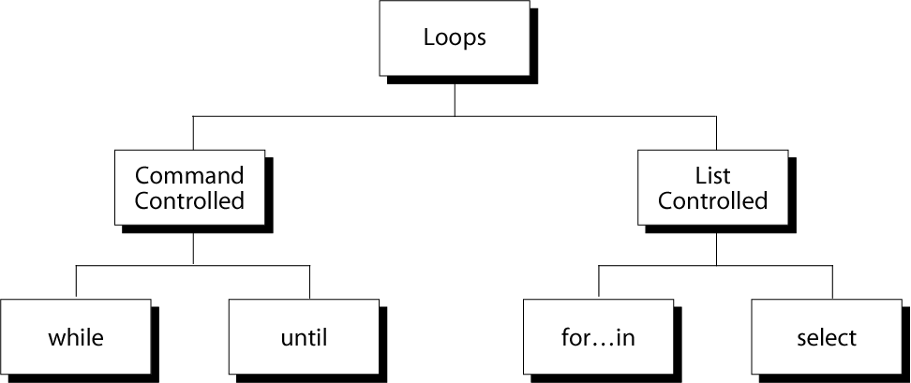
Repetition Constructs

Slide 34
The while Loop
Purpose:
To execute commands in “command-list” as long as “expression” evaluates to true
Syntax:
while [ expression ]
do
command-list
done

Slide 35
Example: Using the while Loop
#!/bin/bash
COUNTER=0
while [ $COUNTER -lt 10 ]
do
echo The counter is $COUNTER
let COUNTER=$COUNTER+1
done

Slide 36
The until Loop
Purpose:
To execute commands in “command-list” as long as “expression” evaluates to false
Syntax:
until [ expression ]
do
command-list
done

Slide 37
Example: Using the until Loop
#!/bin/bash
COUNTER=20
until [ $COUNTER -lt 10 ]
do
echo $COUNTER
let COUNTER-=1
done

Slide 38
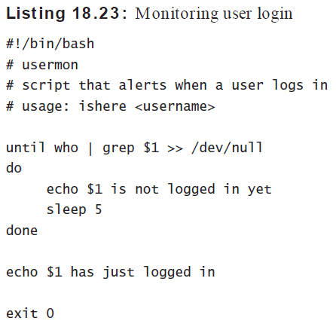

Slide 39
The for Loop
Purpose:
To execute commands as many times as the number of words in the “argument-list”
Syntax:
for variable in argument-list
do
commands
done

Slide 40
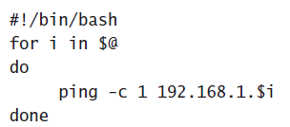
Example 1: The for Loop
#!/bin/bash
for i in 7 9 2 3 4 5
do
echo $i
done
Finding All Available IP Addresses

Slide 41
Example 2: Using the for Loop
#!/bin/bash
# compute the average weekly temperature
for num in 1 2 3 4 5 6 7
do
read -p "Enter temp for day $num: " Temp
let TempTotal=$TempTotal+$Temp
done
let AvgTemp=$TempTotal/7
echo "Average temperature: " $AvgTemp

Slide 42
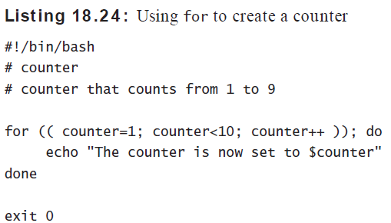

Slide 43
Select command
Constructs simple menu from word list
Allows user to enter a number instead of a word
User enters sequence number corresponding to the word
Syntax:
select WORD in LIST
do
RESPECTIVE-COMMANDS
done
Loops until end of input, i.e. ^d (or ^c)

Slide 44
Select example
#! /bin/bash
select var in alpha beta gamma
do
echo $var
done
Prints:
1) alpha
2) beta
3) gamma
#? 2
beta
#? 4
#? 1
alpha

Slide 45
#!/bin/sh
echo "Enter a number between 1 and 10. "
read NUM case $NUM in
1) echo "one" ;;
2) echo "two" ;;
3) echo "three“ ;;
4) echo "four" ;;
5) echo "five" ;;
6) echo "six" ;;
7) echo "seven"
;; 8) echo "eight" ;;
9) echo "nine" ;;
10) echo "ten" ;;
*)
echo "INVALID NUMBER!" ;;
esac

Slide 46
#!/bin/bash
echo "Which is Your Favorite Linux distribution..?“
select os in Ubuntu LinuxMint CentOS RedHat Fedora
do
echo "I also like $os !"
done

